Slide 1
Predictive Model Testing
Securities and Digital Assets
Andrei, Jon, Lareeb, Michelle, Tara
Notes:
Tara

Slide 2
Agenda
Motivation/Summary
Model Summary
Data Cleanup & Model Training
Model Evaluation
Discussion
Postmortem
Questions
Notes:
Tara

Slide 3
Motivation & Summary
Project one peaked interest in delving more into predictability of 4 assets
  SPY, Gold, BTC and ETH
Can we use machine learning to predict future prices of assets
What model is best at predicting future prices
Best tool to evaluate model
Notes:
Tara -Based on first project, we saw there was a point where S&P 500 crossed Bitcoin, which caused us to believe S&P 500 might be a leading indicator for Bitcoin prices.
Predicted future prices of 4 assets - SPY, Gold, BTC and ETH
Time frame:
One year period
LSTM predictive models for 4 assets - Gold, SPY, BTC and ETH
We used historical pricing data for a one year period, and trained our models to predict future prices.
We then completed on secondary analysis on a longer date range, up to current day.
We then used Sci-Kit Learn and Tensorflow to test the mean absolute percentage error for each asset class.

Slide 4
Model Summary
Model used and why
  LSTM was used for prediction of 4 assets
    LSTM was used as it is more sophisticated than a standard RNN model
      LSTM more suited to classifying, processing and making predictions on time series data
      LSTM deals with vanishing gradient problem that can be encountered when training traditional RNNs
      LSTM architecture allows model to learn longer term dependencies
Notes:
Michelle - The main difference between an LSTM unit and a standard RNN unit is that the LSTM unit is more sophisticated. More precisely, it is composed of the so-called gates that supposedly regulate better the flow of information through the unit.

Slide 5
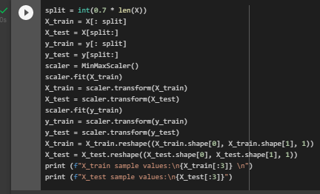
Data Cleanup and Model Training
We used the DataFrames we created for each asset in the prior project.
We created models for each asset, and then trained and tested each model.
We ran each model for 100 Epochs.
Notes:
Michelle - The main difference between an LSTM unit and a standard RNN unit is that the LSTM unit is more sophisticated. More precisely, it is composed of the so-called gates that supposedly regulate better the flow of information through the unit.

Slide 6
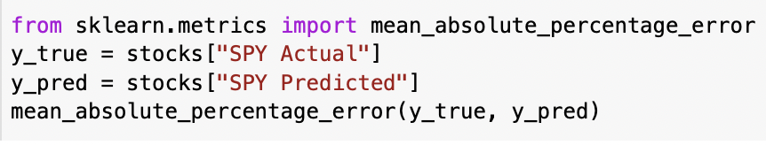
Model Evaluation - Gold
Mean Absolute Percentage Error (MAPE) is commonly used because it’s easy to interpret and explain. For example, a MAPE value of 11.5% (.115) means the average difference between the forecasted and actual value is 11.5%. The lower the value for MAPE, the better a model is able to forecast values. Feb 27, 2020 – statology.org
Asset | Mean Absolute % Error
SPY | 0.02137092813390049
GOLD | 0.014784009823776893
BTC | 0.06374552301709513
ETH | 0.22953520557197069
Notes:
Michelle -(MAPE = Mean Absolute Percentage Error) One issue we encountered was using model evaluation tools that weren’t appropriate for a model that predicts price.We ran a Confusion Matrix, and a Classification report - both were unsuccessful due to evaluating for “hot dog/not hot dog” accuracy, and we were predicting for price.We then successfully used a percentage of error analysis to evaluate our models.

Slide 7
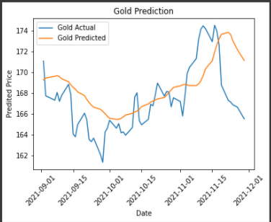
Model Evaluation - Gold
Notes:
Michelle -(MAPE = Mean Absolute Percentage Error) One issue we encountered was using model evaluation tools that weren’t appropriate for a model that predicts price.We ran a Confusion Matrix, and a Classification report - both were unsuccessful due to evaluating for “hot dog/not hot dog” accuracy, and we were predicting for price.We then successfully used a percentage of error analysis to evaluate our models.

Slide 8
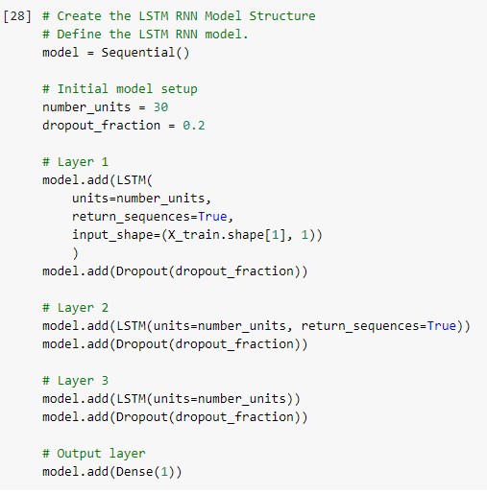
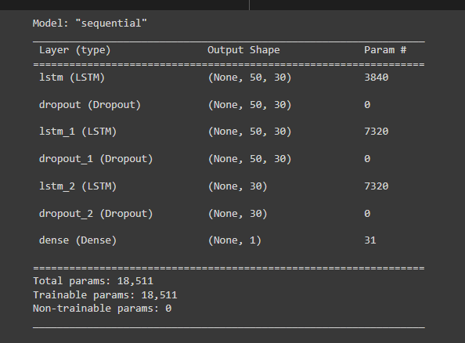
Creating a LSTM
Notes:
Lareeb - ^ i like this or should i grab the actual code for running the lstm and challenges and errors in making that work
Whatever you’re comfortable with to be honest :-)

Slide 9
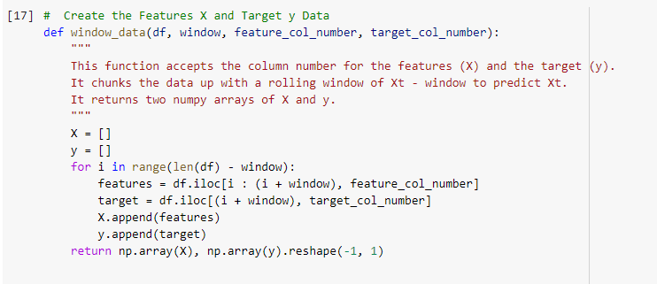
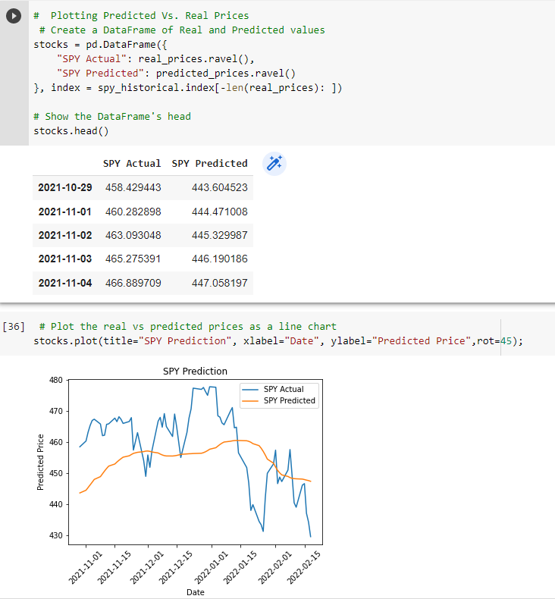
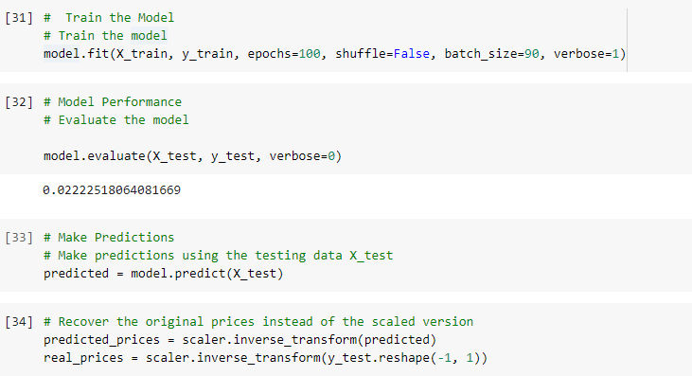
Making Sense of the Data
Notes:
Lareeb - Talk about defining data and getting numbers and turning that into visualisations in order to make sense out of it
Up to you :-)
I do like these 2 slides because it provides a nice segway into the jonrant (LOL)

Slide 10
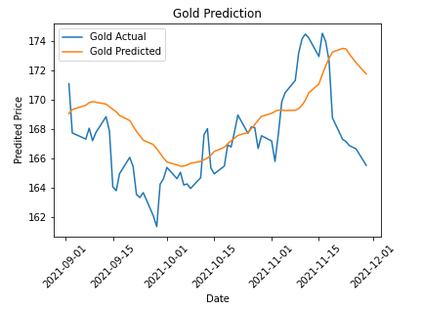
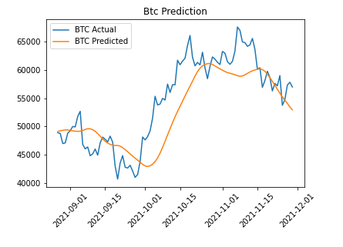

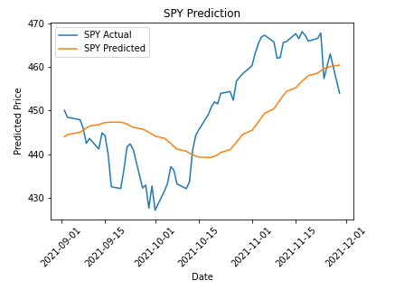


Model Evaluation - Original TimeFrame
Notes:
Jon - looking at charts with original data → next chart ethereum old data → next chart new data → next chart

Slide 11
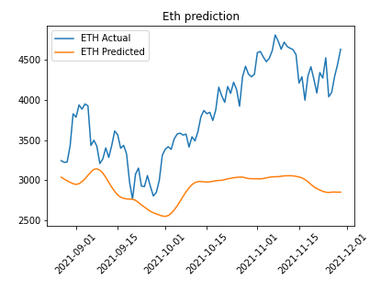
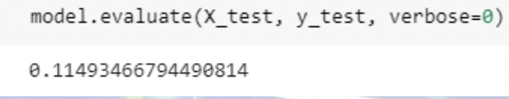

Model Evaluation - Original TimeFrame ETH
Jon →
Notes:
Jon - ETH…… to YEET or not to YEET… that was the question.

Slide 12
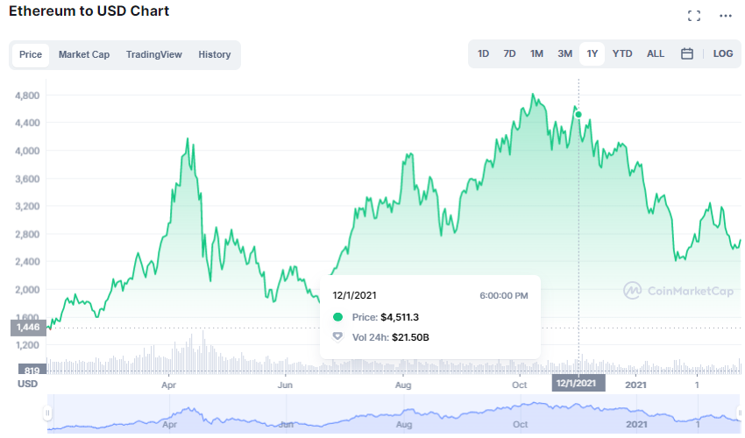
Model Evaluation - ETH
Notes:
Jon - somethings up here… and we had months more of data we could include. Current day price is actually pretty close to where our predicted price couldn’t get over.

Slide 13

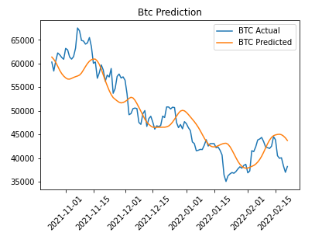
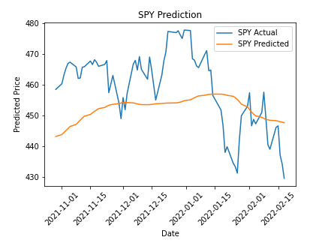
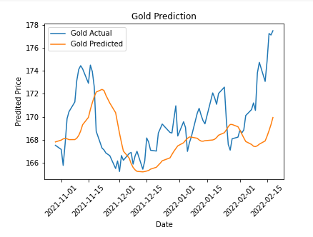


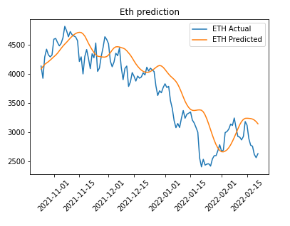


Model Evaluation - NEW TimeFrame
Notes:
Jon - New timeframes didn’t look better to me, with spy and gold, error ratio looked good still for them though.
I was blown away with the improvement of the crypto predictions.
Save further analysis for post mortem???

Slide 14
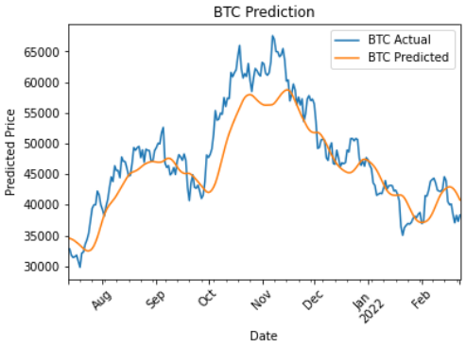
Model Evaluation - BTC
Notes:
Jon - Visualizing the improvements as more recent time data is added to our model

Slide 15

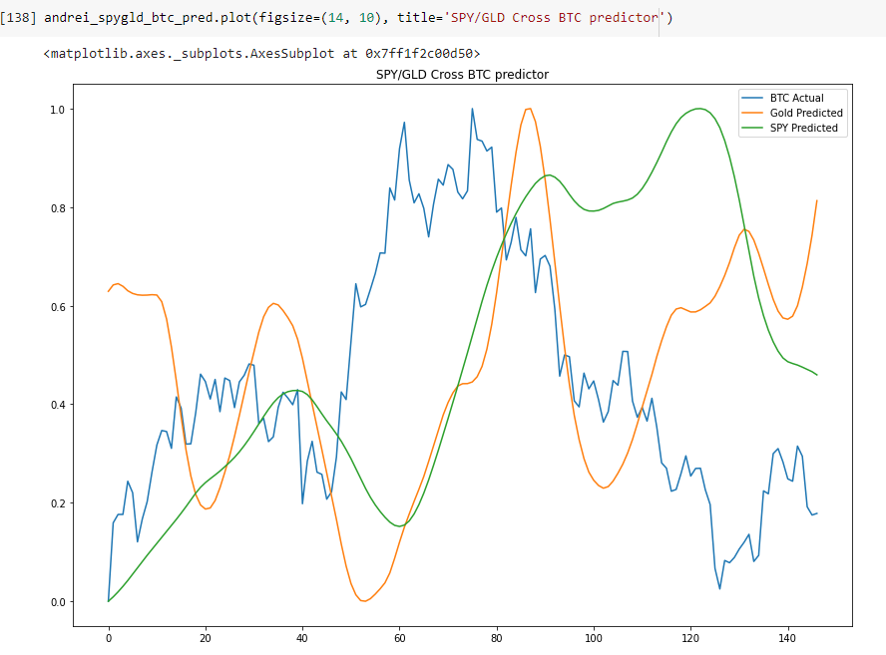
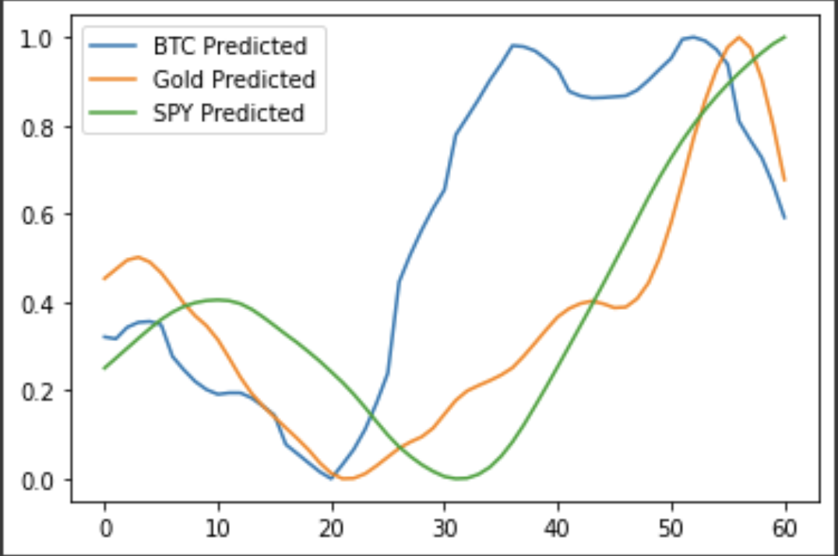
Trying to Predict BTC via Gold and SPY
Notes:
Lareeb - talk about how originally we were looking to predict btc price based off a cross of gold and spy and how that generally didn’t yield fruitful info, (honestly i think based off this chart btc would be a better predictor of gold and spy and not vice versa) (these are our predictions only, we’d need a chart that shows actual, to see what happened to actual prices after crosses occurred in this one -JE)
WHEN GOLD CROSSES SPY FROM BELOW TO ABOVE, IT SEEMS TO INDICATE A DROP IN BTC COMING

Slide 16




So you’ve got a model..Now What??
Notes:
Jon - how to trade it. Well I’d short the fuck out of gold… especially on the gold, it struck me that the distance between the two lines is actually very telling, it seems that once the distance reaches a certain point, it’s very telling of a price reversal. Very nice for a mean reversion strategy on GLD and SPY. Strangely enough, it seems that

Slide 17
Bull vs. Bear Market
Notes:
Jon - this was actually a nice visual representation of two different markets as well. As to my previous point, look at gold, you can see the double top of actual price in both charts.
On the left, the gap between predicted and actual is huge, which in our model is indicative of a turnaround, and if you look to the right side, it marks the low of early december.
I also want to point out how tight these models get in a bear market.

Slide 18
QUESTIONS????

Slide 19
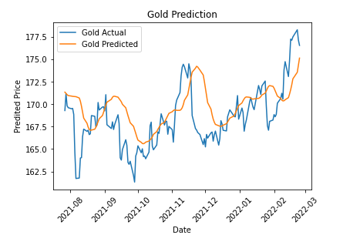
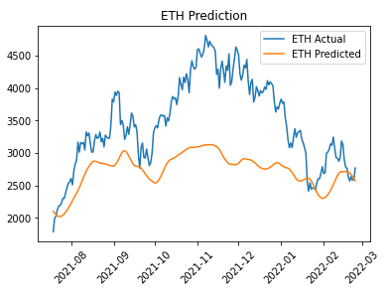
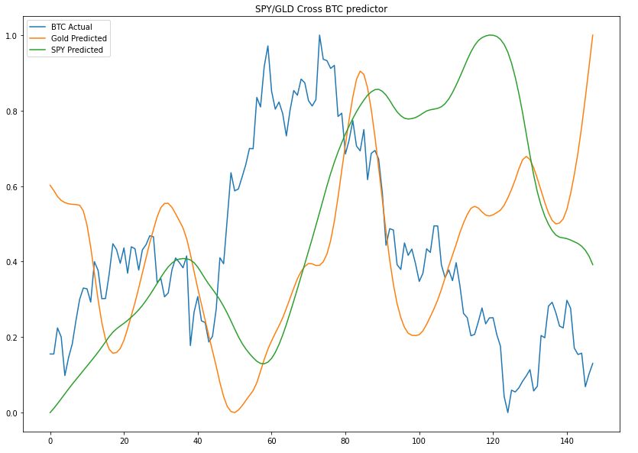
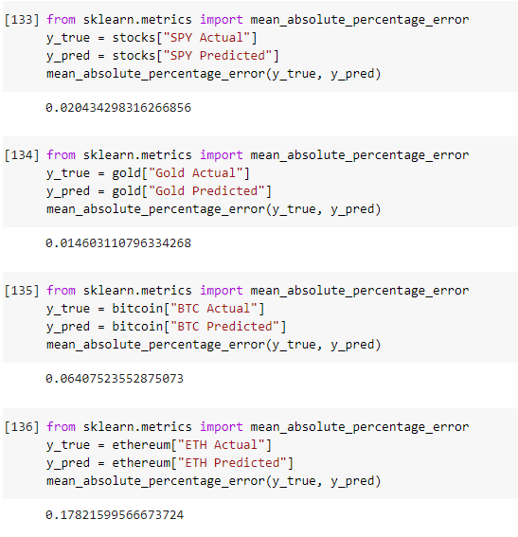
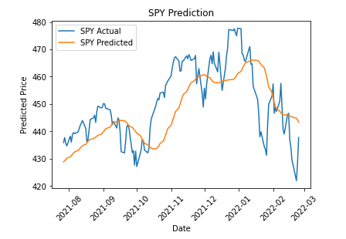
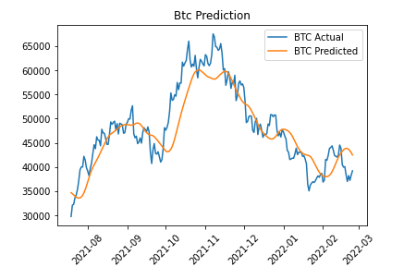
Most Recent Data

Slide 20
